Slide 1




Health and Safety Practices in the Nanomaterials Workplace: Results from an International Survey
Joseph Conti
Nanotechnology and Occupational Health and Safety Conference
November 15 - 17, 2007
University of California, Santa Barbara

Slide 2

Research project team
Donald Bren School of
Environmental Science and Management
University of California, Santa Barbara
NSF NSEC: Center for Nanotechnology in Society at University of California, Santa Barbara
Graduate Researchers:
Gina Gerritzen
Li-Chin Huang
Keith Killpack
Maria Mircheva
Principal Investigators:
Dr. Patricia Holden, PI
Dr. Magali Delmas, Co-PI
Research Mentor:
Joseph Conti, PhD Candidate, Sociology
Principal Investigators :
Dr. Barbara Herr Harthorn, Co-PI
Dr. Rich Appelbaum, Co-PI

Slide 3
What’s distinctive about the study?
Benchmark understanding of safety practices in an international context
Both Environmental, Health and Safety (EHS) and product stewardship of nanomaterials
Global in scope
Publicly available
  http://icon.rice.edu/
  http://www.cns.ucsb.edu
Includes industry, university and research labs

Slide 4
Survey
Conducted between June and September 2006
Confidentiality and anonymity ensured
Pretesting
Telephone Interviews (n=39)
3rd party written administration (n=37)
    Japan and China (PRC)
Web Survey (n=6)

Slide 5
Sample Characteristics
357 organizations contacted; 82 participated
14 countries
NANOVIP.com estimates 1,700 nanotech companies worldwide (labs excluded) (November 2006)
Estimated 16% contact rate for companies
# Contacted | # Respondents | Response Rate (%) | Region
178 | 25 | 14% | North America
102 | 43 | 41% | Asia
69 | 11 | 16% | EU
8 | 3 | 38% | Australia
357 | 82 | 23% | Overall

Slide 6
Private, young, and small
Sample characteristics, continued.
Private (71%, n=58)
Less than 10 years old(57%, n=47)
< 50 workers handling nanomaterials (84%, n=65)
Small or pilot scales (63%, n=52)
Most respondents were management, scientists or a combination
Notes:
))

Slide 7
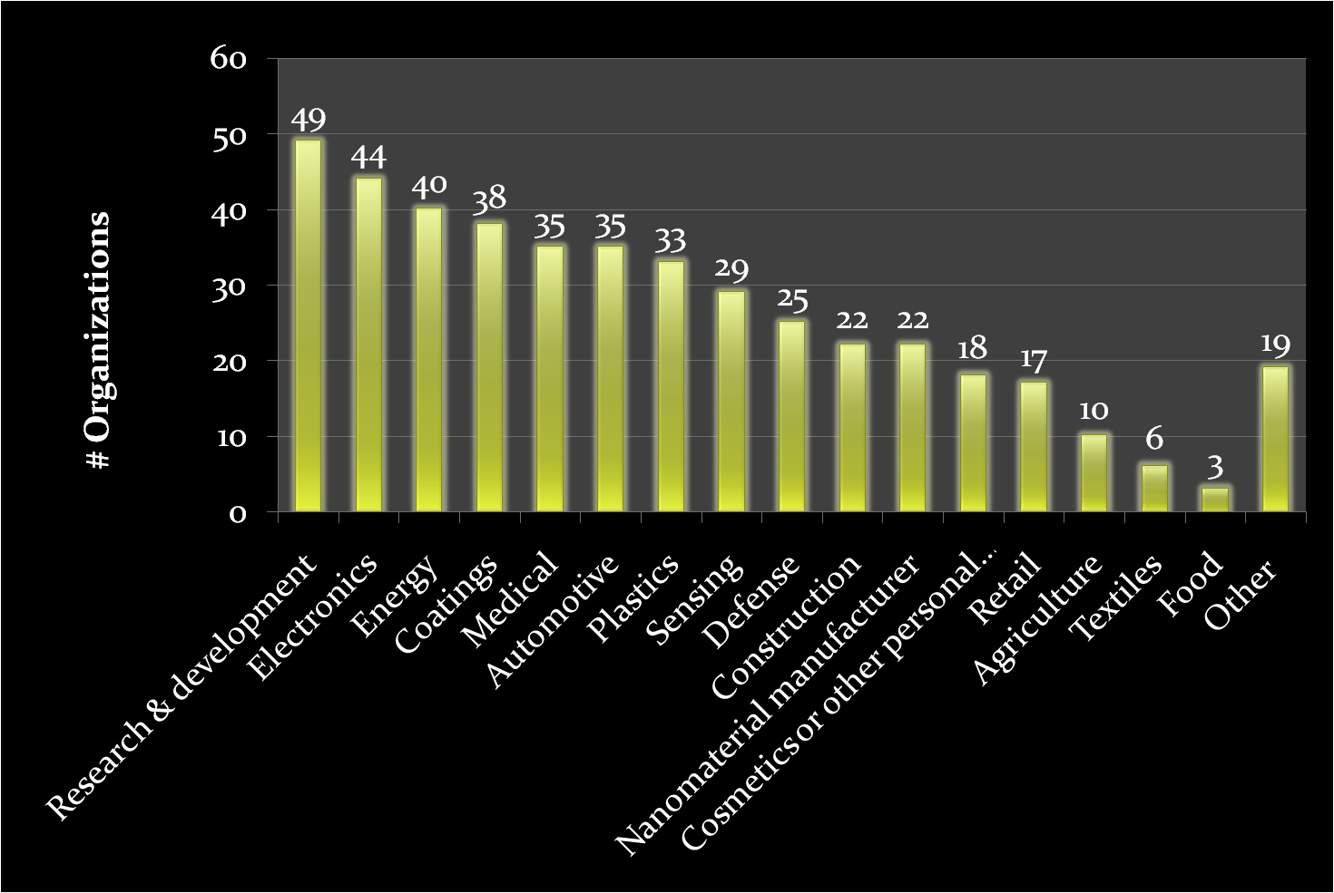
Business activities
Sample characteristics, continued.

Slide 8
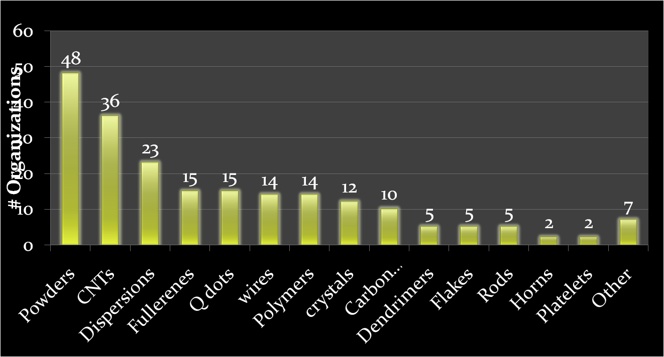
Nanomaterials
Sample characteristics, continued.
Nomenclature an issue; but four most commonly handled nanomaterials

Slide 9
Key Findings
Nanotechnology organizations worldwide are about split on whether or not special risks exist, though more reported that there are not special risks.
Overall, organizations reported behaviors that demonstrate a precautionary approach based on limited knowledge
Most measures were derived from conventional chemical hygiene
Both novel and potentially suspect practices reported
Product stewardship practices remain in development

Slide 10
Waste Management
Most respondents (34/63) reported not discarding nanomaterials as hazardous waste
Most North American, European and Australian firms disposed of their nano-waste as hazardous, while two organizations in Asia reported doing so
36 of 61 respondents do not label their waste as nanomaterial (label by bulk material)

Slide 11
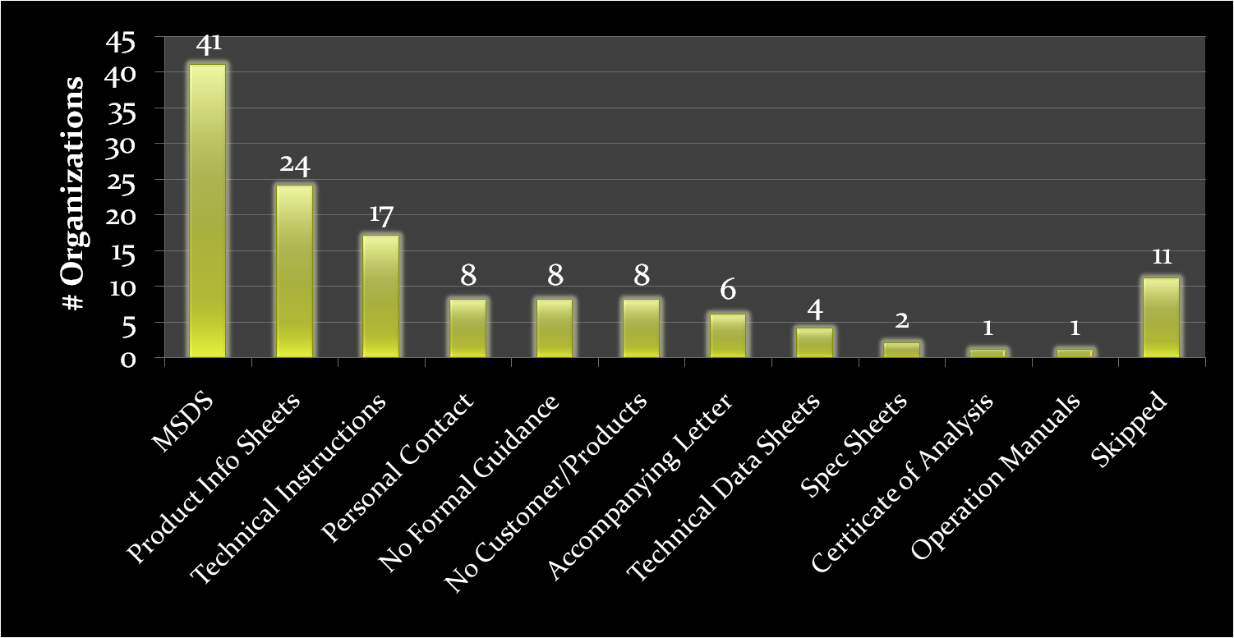
Safe Use
71% (n=58) report having guidance for safe use of nano-products

Slide 12
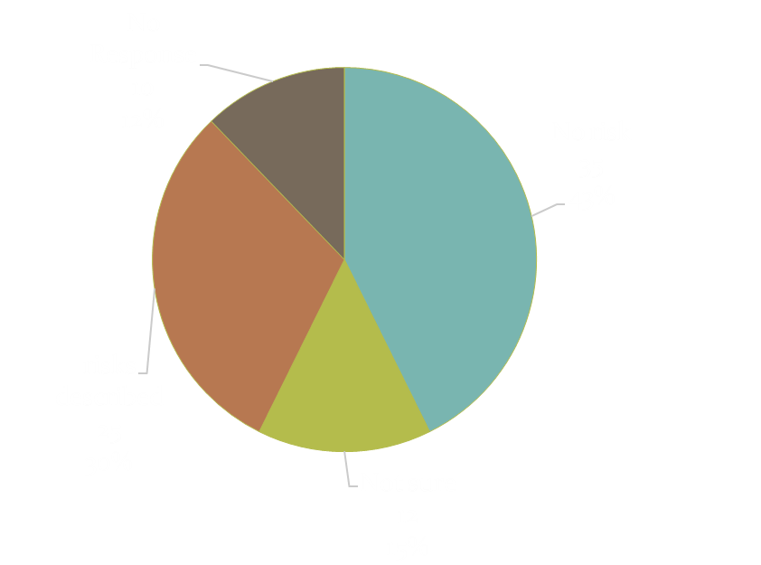
Reported Nanomaterial Risk Beliefs
Leading concerns include inhalation exposure and potential for flammability
One report of concern for dermal exposure
Most (75%) do not perform or fund toxicological testing of their nanomaterials

Slide 13
EHS Programs
73 (89%) respondents report implementing a general EHS program
57 (70%) describe a nano-specific EHS program
Nano-specific EHS programs are more prevalent in organizations that:
  Have worked with nanomaterials for a longer time
  Have more employees handling nanomaterials
  Believed there are special risks associated with their nanomaterials

Slide 14
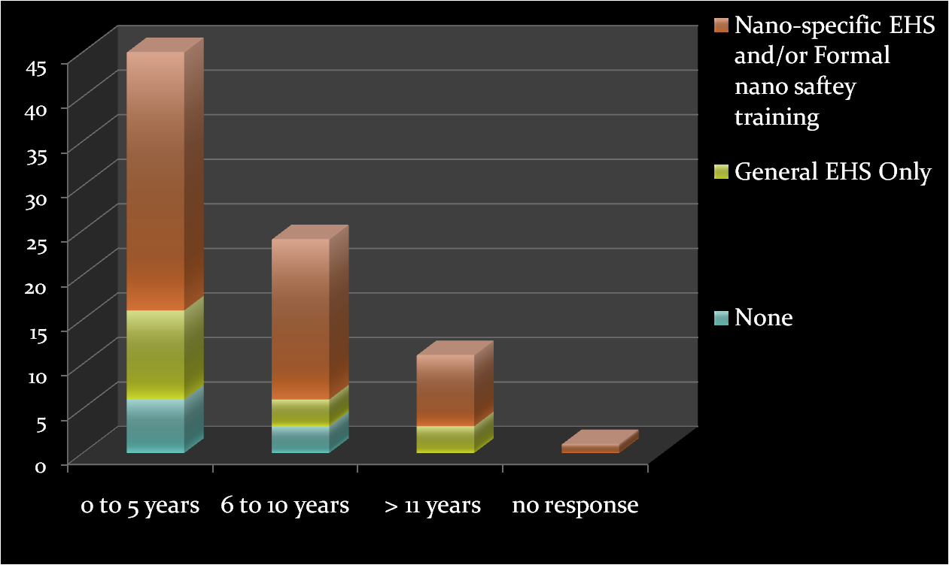
Years handling nanomaterials and EHS programs

Slide 15
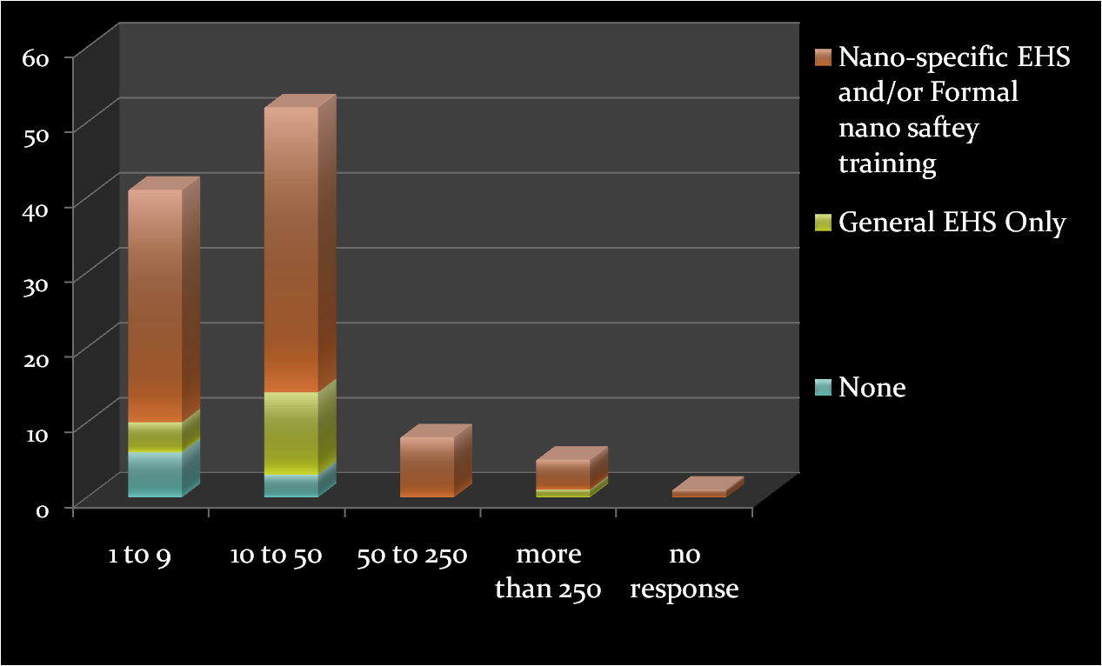
Number of Employees handling nanomaterials and EHS programs

Slide 16
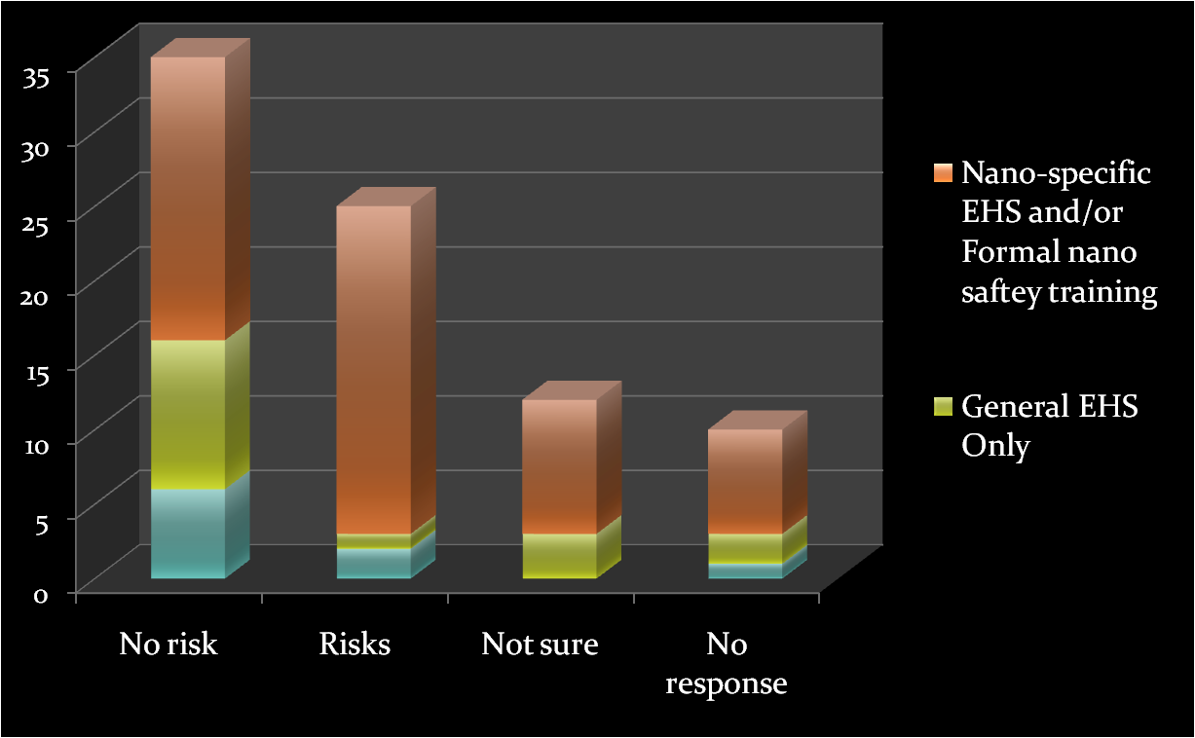
Reported Risk Beliefs and EHS Programs

Slide 17
Reported Impediments to Nano-Specific Practices
44/82 described impediments
Primary impediment is lack of information
Top ranked sources used for determining risks of nanomaterials
  scientific literature
  government regulations and guidelines
  expert consultation
External impediment |  | 37
 | Lack of information and guidelines | 31
 | Legal liability | 2
Internal impediment |  | 12
 | Cost concerns | 9
 | Lack of EHS prioritization | 4
 | Dissemination of information within organization | 2
no impediments |  | 18
no response |  | 20

Slide 18
Overall Implications
Lack of information and guidance are the primary reported impediment
Most pressing demand is for research on nanotoxicology, hazard assessment and safe handling methods for nanomaterials
Novel practices identified in this study could be the basis of future systematic study
Smaller organizations should be targeted for safety messages
Geographical variation in safety practices
Safety and product stewardship require a global approach

Slide 19
Health and Safety Practices in the Nanomaterials Workplace: Results from an International Survey
Joseph Conti
Nanotechnology and Occupational Health and Safety Conference
November 15 - 17, 2007
University of California, Santa Barbara

